Slide 1
PRESENTATION OF OBJECT-ORIENTED PROGRAMMING

Slide 2
Contents
History of programming languages
Difference between Structured Programming and Object-Oriented Programming
The Principles of Object-Oriented Programming

Slide 3
The History of Programming Languages

Slide 4
1957- Fortran created by John Backus to perform high-level scientific, mathematical and statistics computation
1959- Cobol (short for "Common Business-Oriented Language) Primarily for business computing. The team was lead by Dr. Grace Murrray Hopper
1964- BASIC (acronym for “Beginner’s All-purpose Symbolic Instruction Code”) Developed by students at Dartmouth, College. Designed for simplicity.
1970- Pascal (named after French mathematician/physicist Blaise Pascal) Created by Niklaus Wirth, For teaching structured programming and data structuring.
1972- C (based on an earlier language called "B") Created by Dennis Ritchie, for Unix systems, system programming
1983- C++ (formerly “C with Classes”; ++ is the increment operator in “C”)developed by Bjarne Stroustrup modified C to C++ language.
1991- Python, Monty Python served as the inspiration for the name, created by Guido Van Rossum. Created to support a variety of programming
1995- Java , A team of Sun Microsystems developers lead by James Gosling. Made for an interactive TV project
1995- JavaScript created by Brendan Eich of Netscape.Created to extend web page functionality.

Slide 5
Structured Programming Vs. Object-Oriented Programming
STRUCTURED PROGRAMMING | OBJECT-ORIENTED PROGRAMMING
Structured Programming is designed to focus on process structure and the data required for that process. | Object Oriented Programming is designed which focuses on data.
Structured programming follows top-down approach. | Object oriented programming follows bottom-up approach.
Structured Programming does not supports inheritance, encapsulation, abstraction, polymorphism. | Object Oriented Programming supports inheritance, encapsulation, abstraction, polymorphism, etc
In Structured Programming, Programs are divided into small self contained functions. | In Object Oriented Programming, Programs are divided into small entities called objects.
Data moves openly around the system from function to function. | Data is hidden and can’t be accessed by the external world
Structured Programming provides less reusability, more function dependency | Object Oriented Programming provides more reusability, less function dependency.

Slide 6
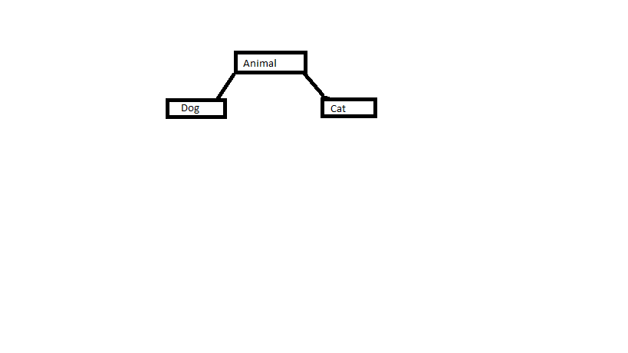
Four major principles of Object-Oriented Programming(OOP)
Encapsulation: Encapsulation means binding the data and code (or) writing operations and methods in single unit (class). For Example- A car.
Abstraction : Abstraction means showing essential features and hiding non-essential features to the user. For Example- Tv Remote.
Inheritance : Deriving a new class from the existing class, is called Inheritance. The derived(sub class) class is getting all the features from Existing (super class\base class) class. For example-
4. Polymorphism: Polymorphism means one name, many forms. One function behaves different forms, depend upon the data passed in the operation. Example- A software engineer can perform different task at different instance of time depending on the task assigned to him

Slide 7
Thank You

